Slide 1
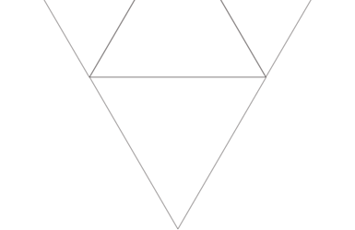

Turing Machine
Team members:
WENQIAN JIA, LINKAI GAO, ZIQI WANG

Slide 2
Background and Composition
01
02
Principle and Implementation
Significance and historical status
03
03

Slide 3


Background and Composition
01
Speaker: WENQIAN JIA

Slide 4
Background
Problem: “Is there an algorithm that takes as input a statement written in formal logic, and produces a “yes” or “no” answer that’s always accurate?”
Turing Machines provided a simple but powerful mathematical model of computation.
It was functionally equivalent to a person performing mathematical operations.

Slide 5
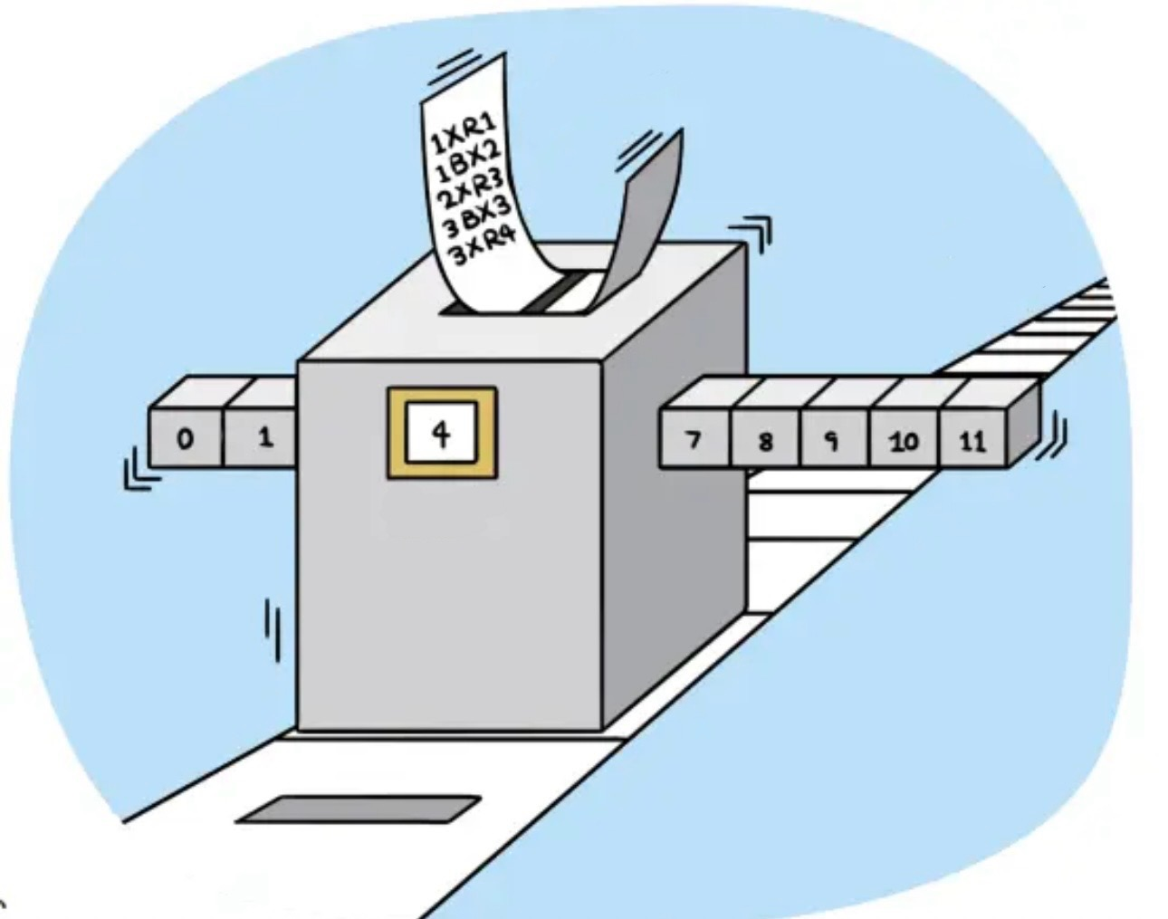
Composition
Transition Function
Tape
Determines the next action based on the current state of the machine and the symbol read by the head.
Serves as the machine's memory, allowing it to store and manipulate information.
States Register
Head
Holds the current state of the Turing machine.
Is the machine's primary means of interacting with its environment.

Slide 6
02
Principle
and Implementation
Speaker: LINKAI GAO

Slide 7
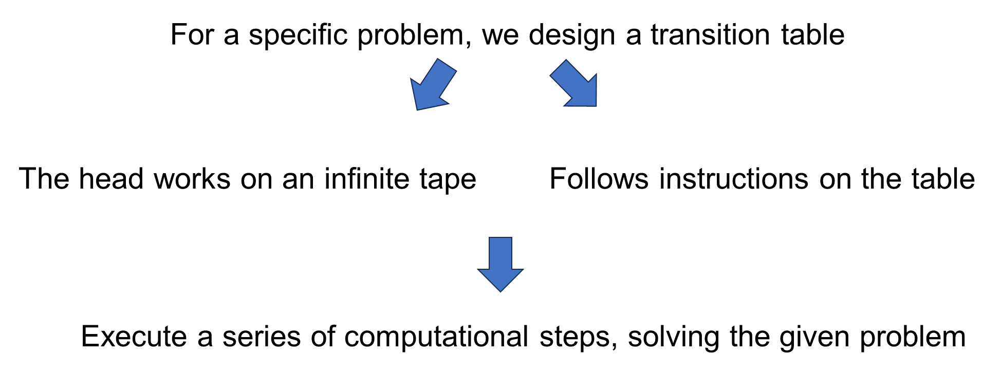
The Essence of a Turing Machine

Slide 8
A Simple Implementation
Let’s use Jupyter Notebook to have a try!

Slide 9
Significance
and
Historical status
03
Speaker: ZIQI WANG

Slide 10
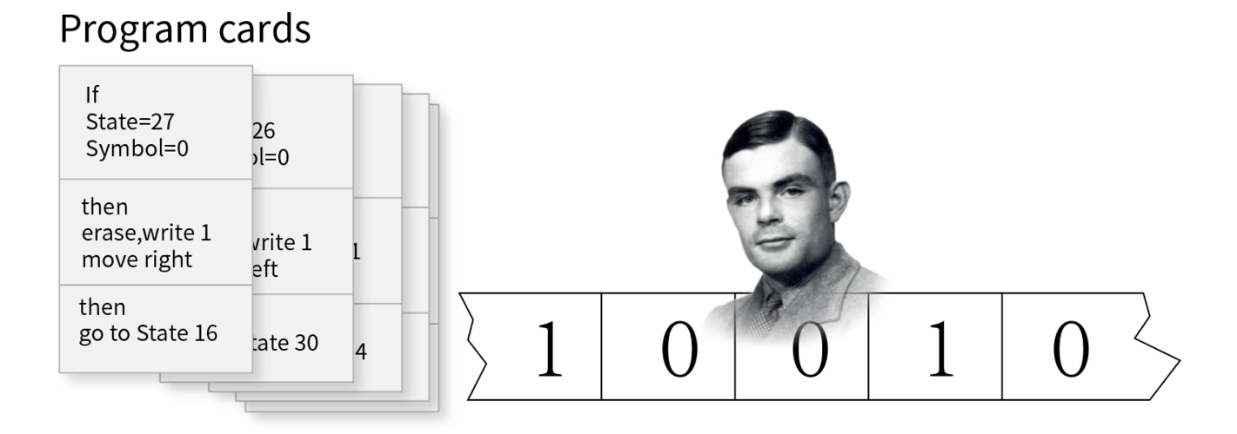
1. Theoretical basis of computation:
Turing machines provide a formal model for understanding the essence of computation.
It defines what is computable and helps define the scope of computable problems.

Slide 11
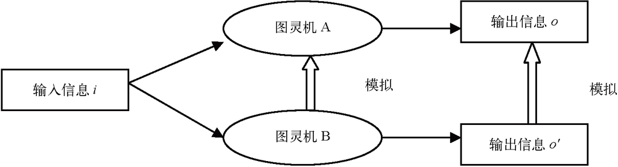
2. Decisive and Non Decisive:
The study of Turing machines enables people to distinguish different computational models. (example)
They also help understand computational complexity, that is, the resources required (such as time and space)
Deterministic
Non deterministic

Slide 12
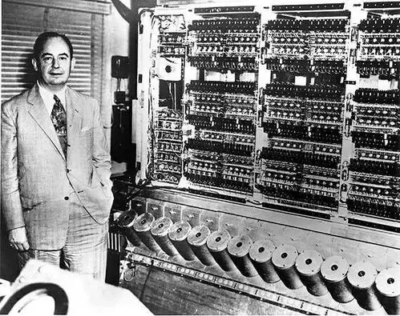
3. Artificial Intelligence :
The "Turing Test" is a standard used to evaluate machine intelligence.
It stimulates the exploration of whether machines have consciousness and comprehension abilities,

Slide 13
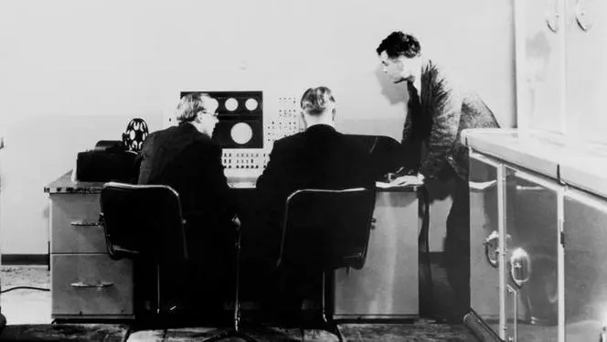
The Historical Status of Turing Machines
Difference Engine
Turing machines
CPU
Turing machine is in the chain
The concept of Turing machines provided theoretical support for the development of modern computers, and laying the foundation for the development of programming languages and other fields.

Slide 14
Thanks!

